Slide 1
Ring Project

Slide 2
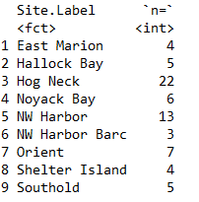
How I filtered the data set
Meats were converted to grams by dividing “meats per pound” 453.6 and rounding to first decimal.
I removed all that did not have an “average meats per pound”, “Total scallops harvested”, and if the collection date did not occur between September 30th –December 31st
Next removed samples based on individual collection sites if a site did not have at least 3 total collections
69 total data points across 9 sites
"East Marion“, "Hallock Bay“, "Hog Neck“, "Noyack Bay“,
"NW Harbor“, "NW Harbor Barc“, "Orient", "Shelter Island“
"Southold"

Slide 3
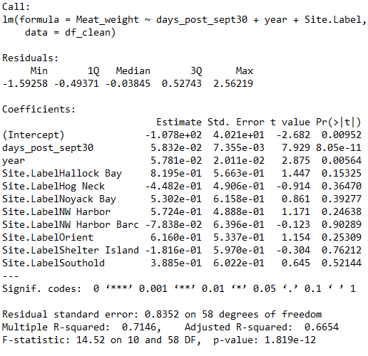
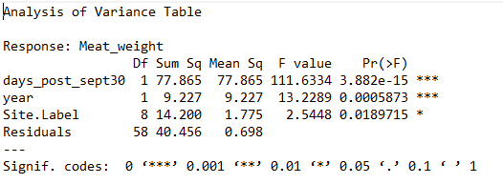

Slide 4
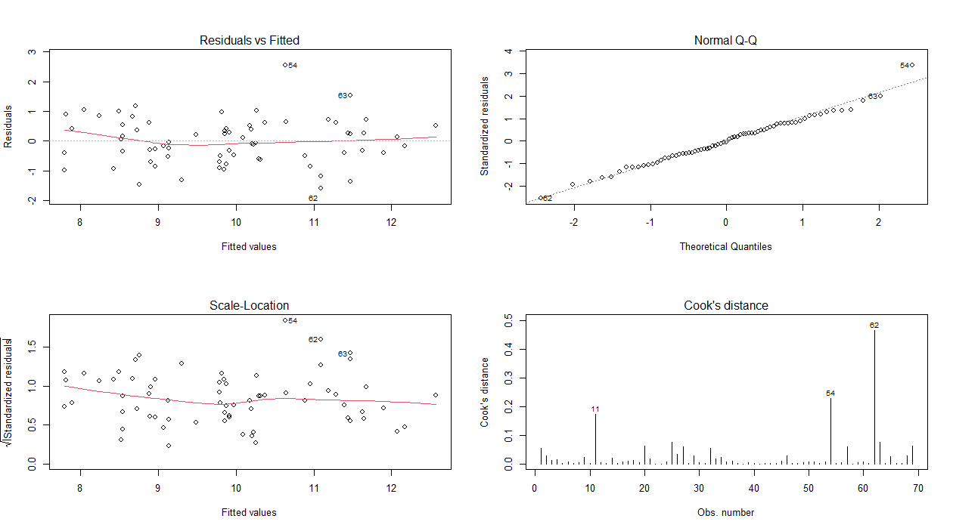

Slide 5
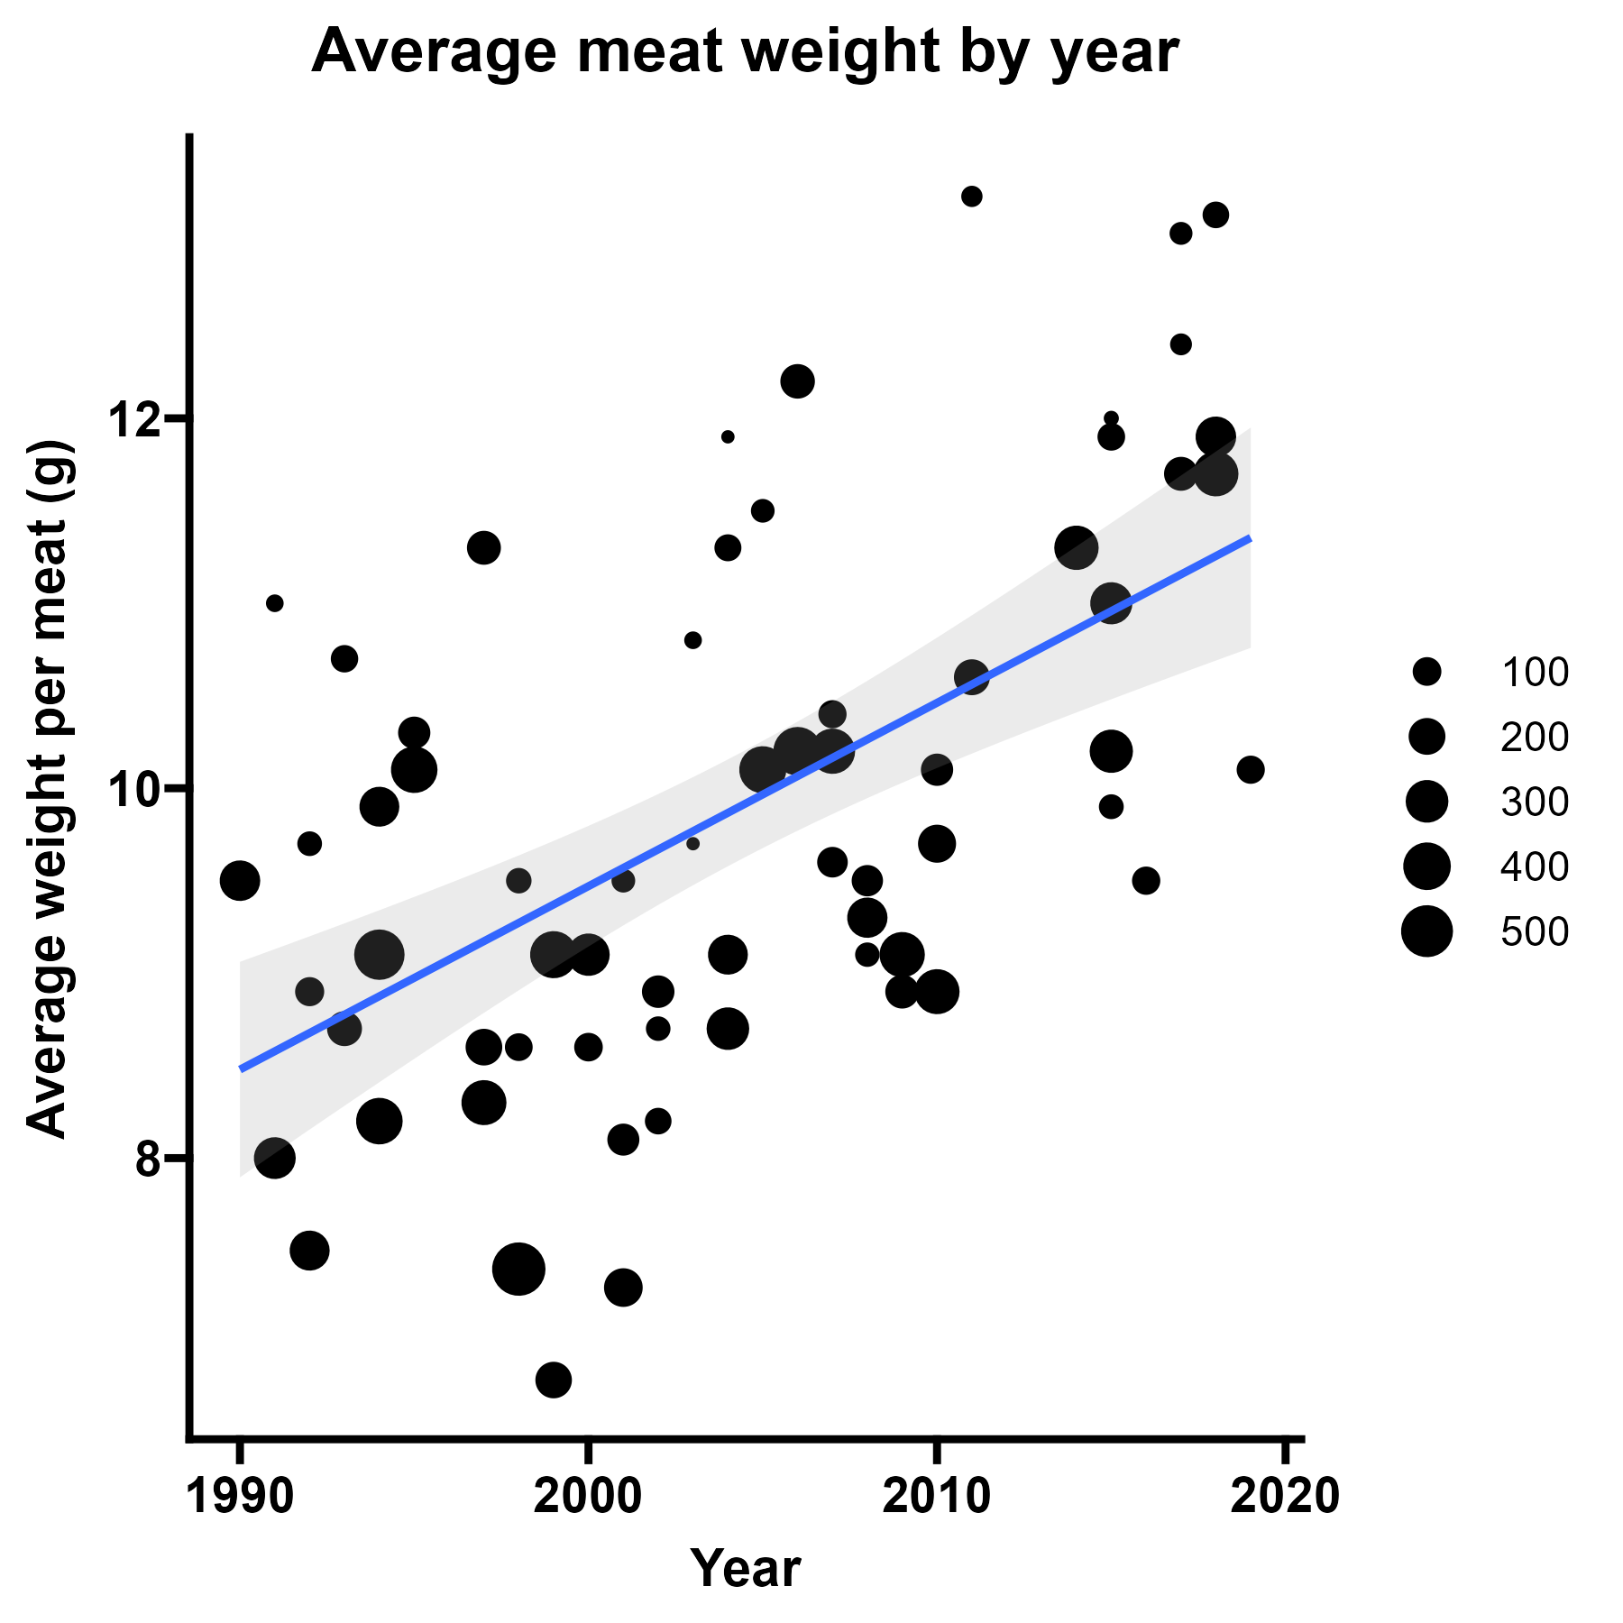
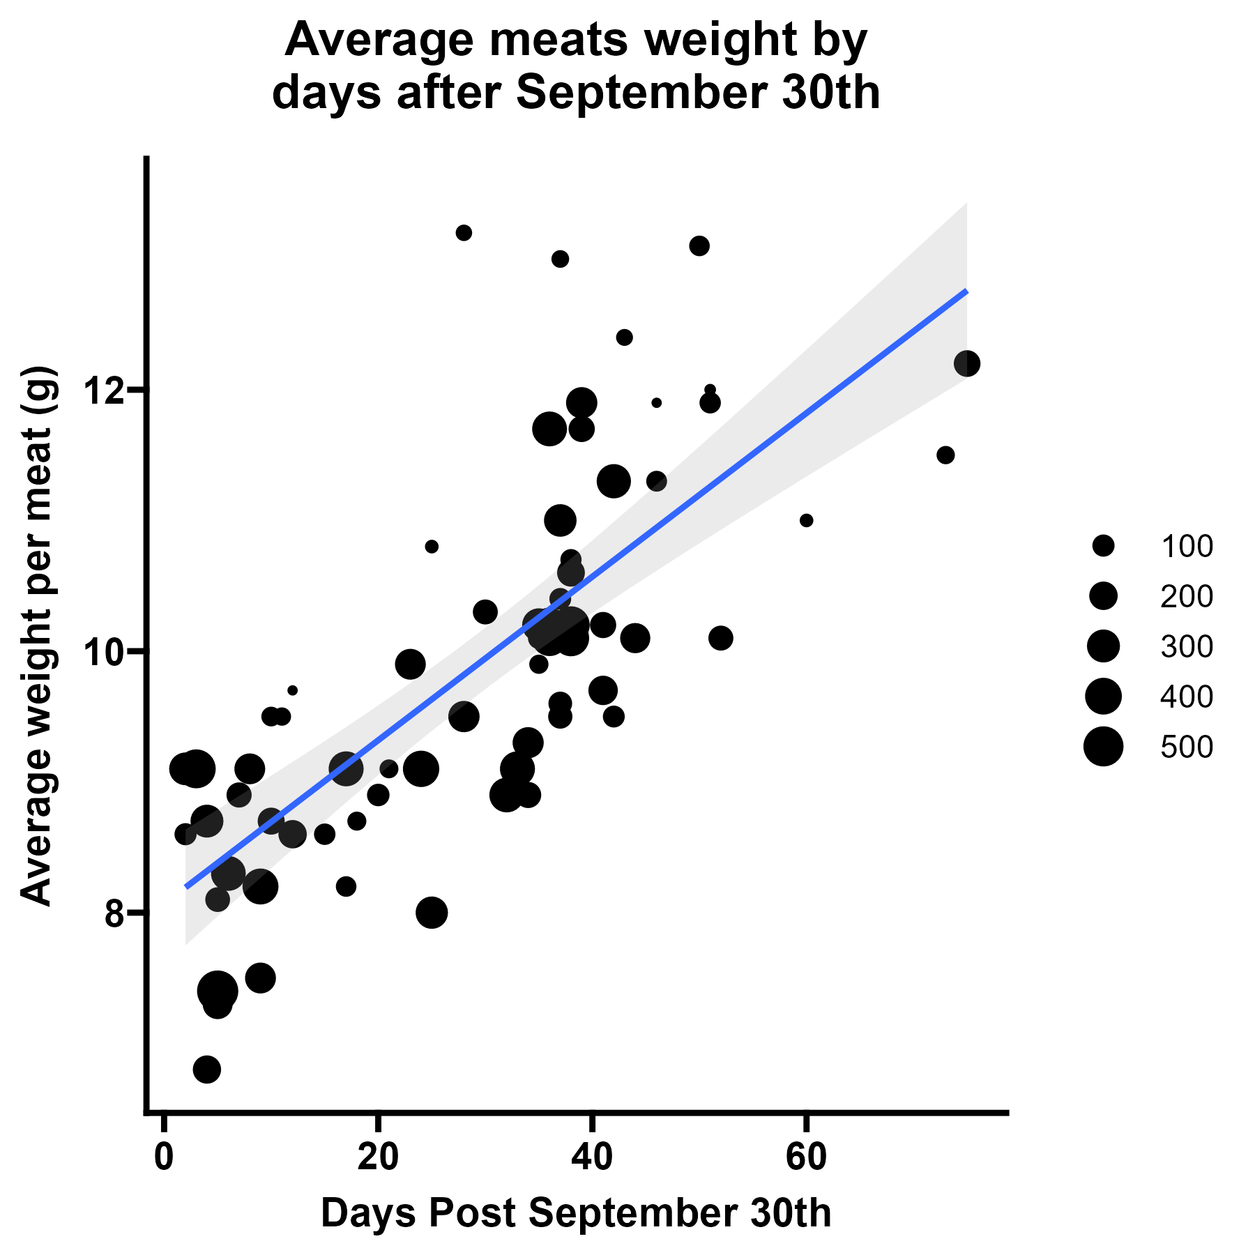

Slide 6
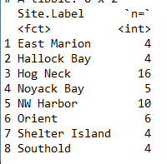
Repeat analysis except between 9/30-11/10
Total of 53 data points across 8 sites

Slide 7
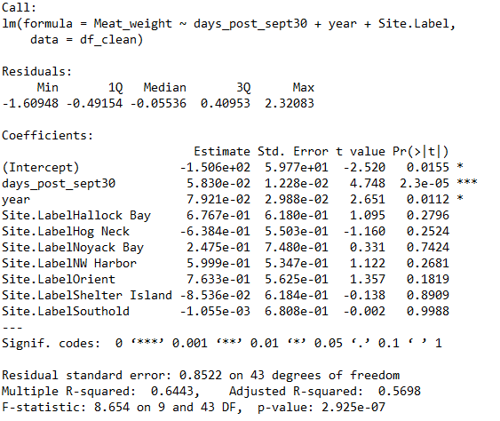
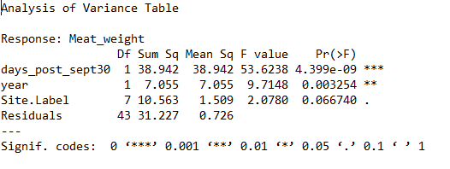

Slide 8
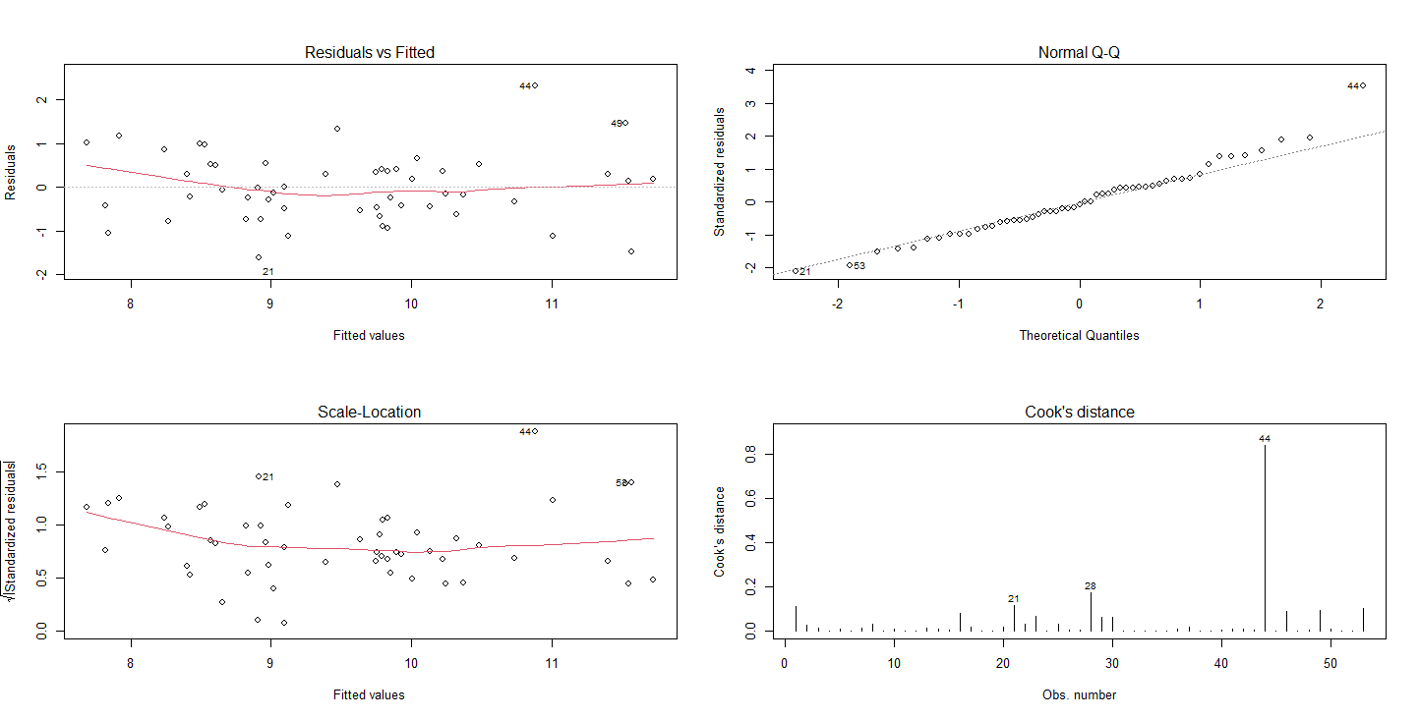

Slide 9
